Slide 1
RESORTS, BEACHES, NATURAL ATTRACTION

Slide 2
THE AZURE WINDOW
IS A LIMESTONE NATURAL ARCH ON THE MALTESE ISLAND OF GOZO. IT IS SITUATED NEAR DWEJRA BAY ON THE INLAND SEA. THE FORMATION, WHICH WAS CREATED AFTER TWO LIMESTONE SEA CAVES COLLAPSED.
FUNGUS ROCK
IS A SMALL ISLET IN THE FORM OF A 60 METERS HIGH MASSIVE LUMP OF LIMESTONE AT THE ENTRANCE TO AN ALMOST CIRCULAR BLACK LAGOON IN DWEJRA, ON THE COAST OF GOZO.
NOWADAYS, FUNGUS ROCK IS A NATURE RESERVE. HOWEVER, THE SHORELINE NEARBY IS ACCESSIBLE TO BATHERS AND THE SEA PROVIDES PERFECT SNORKELING.

Slide 3
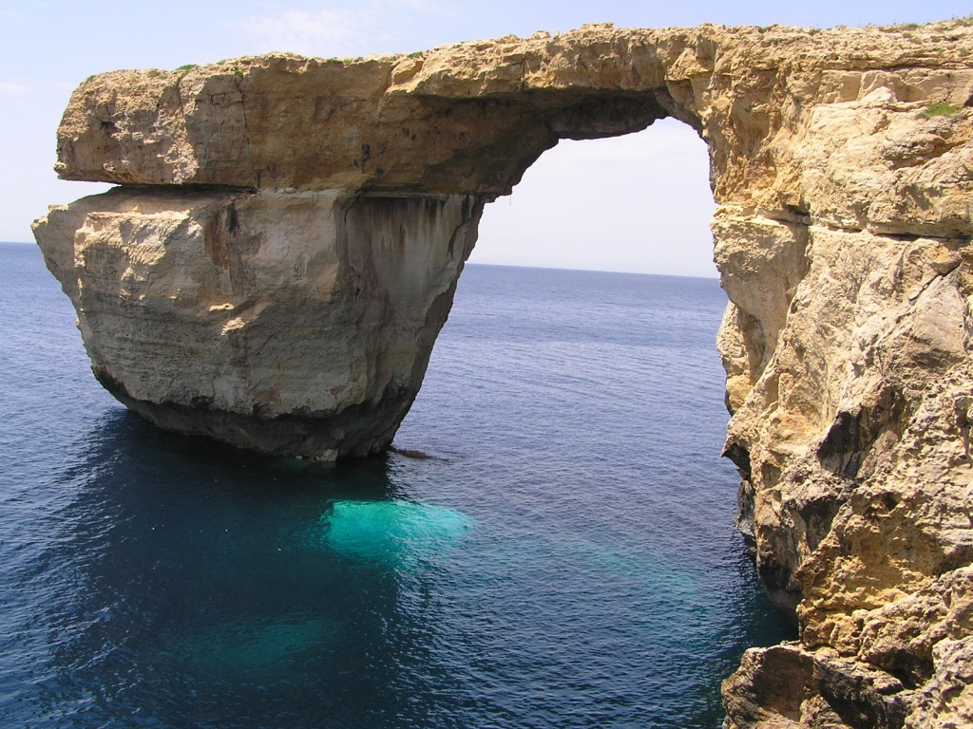
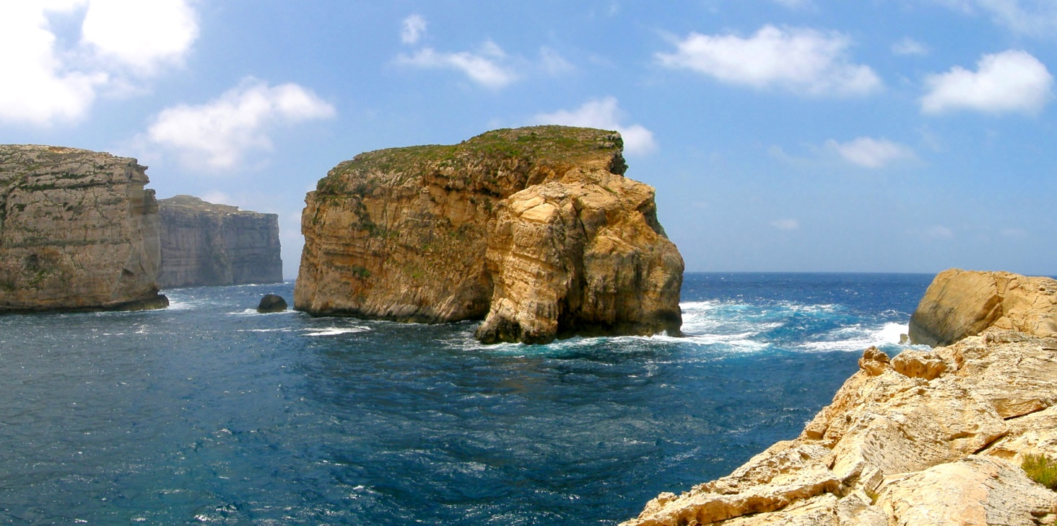

Slide 4
CAVES
THE BEST KNOWN CAVES:
-GHAR LAPSI
-GHAR IT-TORKIJA
-GHAR BITTIJA
-GHAR BAGRAT
-GHAR ID-DUHHAN
THERE ARE TWO PRIVATE CAVES IN XAGRA.

Slide 5
MOST OF RESURTS AND MAJOR, SANDY BEACHES ARE LOCATED ON THE NORTHERN COST. SANDY BEACHES ARE 4,5KM LONG, WHICH IS 2,4% OF THE COAST. MAJORITY OF THE MALTESE BEACHES HAVE BEEN ADAPTED FOR TOURISTS.

Slide 6
BAY & BEACHES
ANCHOR BAY
ARMIER BAY
BLUE LAGOON
GHAJN TUFFIEHA
GOLDEN BAY
GNEJNA BAY
MARSALFORN
MELLIEHA BAY
MISTRA
PARADISE BAY
PRETTY BAY
PWALES BEACH
RAMLA BAY
SAN BLAS
SANTA MARIA BAY
ST. GEORGE’S BAY
ST. PAUL’S BAY
ST. THOMAS BAY
XLENDI

Slide 7
ALTHOUGH ONE OF THE SMALLEST SOUNTRIES, MALTA BOASTS TWO NATIONAL PARKS:
-TA’QUALI NATIONAL PARK
-SALINI NATIONAL PARK

Slide 8
RESORTS & REGIONS
The North, the most rugged of all Malta's regions, offers spectacular views across to Comino and Gozo. It also has Malta's most established beach and holiday resorts, Buġibba, Qawra, St. Paul's Bay, and Malta's largest sandy beach at Mellieħa. Also northwards are Malta's other larger sandy bays, Golden Bay, Għajn Tuffieħa and Paradise Bay.
Sliema and St. Julian's are Malta's main coastal resort towns and a heartland for shopping, entertainment and café life. They also house some of Malta's newest hotels and apartments. St. Julian's and Paceville are Malta's main nightlife areas.

Slide 9
The South is characterised by its fishing villages and quiet bays. It offers an authentic insight into Maltese rural life. Most hotels are in the harbour town of Marsaskala, a southern resort which bustles by night yet is charming and quiet by day.

Slide 10
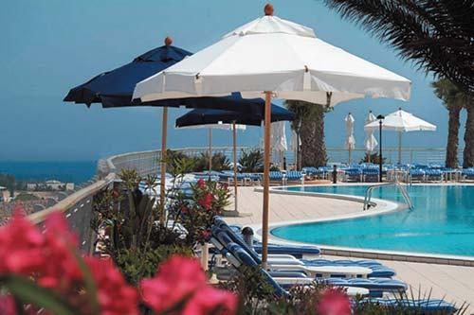
THE BEST 10 RESORTS
db Seabank Resort + Spa
The Riviera Resort & Spa
The Westin Dragonara Resort, Malta
Maritim Antonine Hotel & Spa
Sunseeker Holiday Complex
Sunny Coast Resort & Spa
Mavina Holiday Complex
Hotel Fortina
Diamond Suites on Malta

Slide 11
KaROLINA JANIK

